Slide 1
Meiosis
By
Dr. A. S. Shinde
SCS college, Omerga

Slide 23
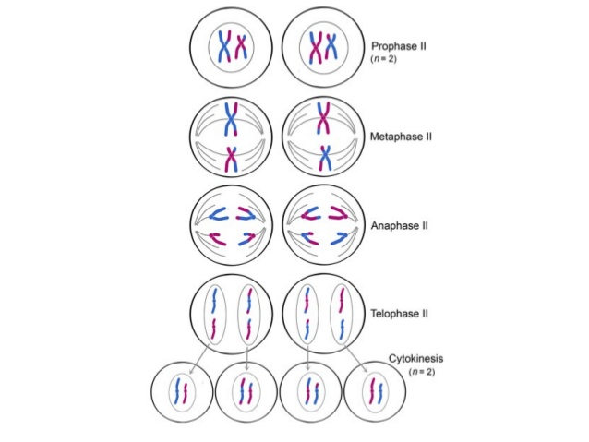

Slide 28
